Slide 1
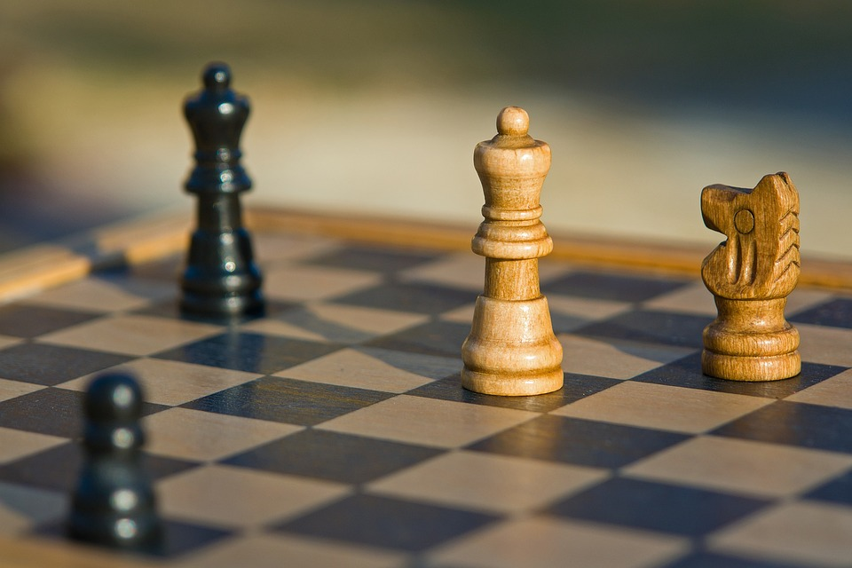
Artificial Intelligence Based Chess Bot Development
Anwesha Kundu 221001020037
Samriddhi Roy 221001020014
Shreyosi Sen 221001020008

Slide 2
Introduction
Project Overview: This project involves developing an AI-based chess game using Python and Pygame. The game allows a human player to compete against an AI opponent, which evaluates and executes moves strategically.
Purpose:
To implement an intelligent chess-playing AI.
To provide an interactive and challenging chess experience.
To explore AI decision-making through classic algorithms.
Technologies Used:
Python – Core programming language.
Pygame – For rendering graphics and handling user interactions.

Slide 3
Understanding The Rules Of Chess
Overview of Chess
Chess is a two-player strategy game played on an 8×8 board with 64 squares alternating between light and dark colors.
Each player controls 16 pieces: 1 King, 1 Queen, 2 Rooks, 2 Knights, 2 Bishops, and 8 Pawns.
The objective is to checkmate the opponent's King, meaning the King is under attack and cannot escape.

Slide 4
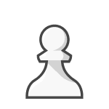

Piece Movements
✅ Pawn:
Moves one square forward (two squares from its initial position).
Captures diagonally one square forward.
Special move: En Passant (capturing a pawn that moves two squares forward as if it moved one).
Reaches the last rank → Pawn Promotion (can be promoted to Queen, Rook, Bishop, or Knight).
✅ Rook:
Moves horizontally or vertically any number of squares.
Cannot jump over pieces.

Slide 5




✅ Bishop:
Moves diagonally any number of squares.
Cannot jump over pieces.
✅ Knight:
Moves in an L-shape (two squares in one direction and one square perpendicular to it).
Only piece that can jump over other pieces.
✅ Queen:
Moves horizontally, vertically, or diagonally any number of squares.
Most powerful piece.
✅ King:
Moves one square in any direction.
Special move: Castling (moves two squares towards a Rook and the Rook moves over the King).

Slide 6
Special Rules
Check & Checkmate:
Check: When the King is attacked but can still escape.
Checkmate: When the King is attacked and has no legal moves to
escape → Game over.
2. Stalemate: If a player has no legal moves but is not in check, the game is draw.
3. Threefold Repetition & 50-Move Rule:
If the same board position occurs three times, the game is a draw.
If no pawn moves or captures occur in 50 consecutive moves, the game is a draw.

Slide 7
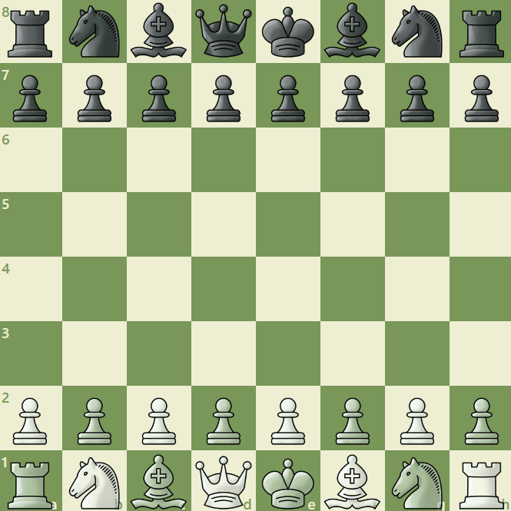
Understanding The Chess Board
Structure of the Chessboard
The chessboard consists of an 8×8 grid with alternating light and dark squares.
Columns are labeled a to h from left to right.
Rows are numbered 1 to 8 from bottom to top.
Each square has a unique identifier (e.g., e4, d5).

Slide 8
Board Representation in Code
The board is represented as a 2D array (8×8 matrix) in Python.
Each square can store a value representing a piece (e.g., ‘P’ for Pawn, ‘K’ for King).
Example:
Board = [['R', 'N', 'B', 'Q', 'K', 'B', 'N', 'R’],
['P', 'P', 'P', 'P', 'P', 'P', 'P', 'P'],
['.', '.', '.', '.', '.', '.', '.', '.’],
['.', '.', '.', '.', '.', '.', '.', '.'],
['.', '.', '.', '.', '.', '.', '.', '.’],
['.', '.', '.', '.', '.', '.', '.', '.'],
['p', 'p', 'p', 'p', 'p', 'p', 'p', 'p’],
['r', 'n', 'b', 'q', 'k', 'b', 'n', 'r']]

Slide 9
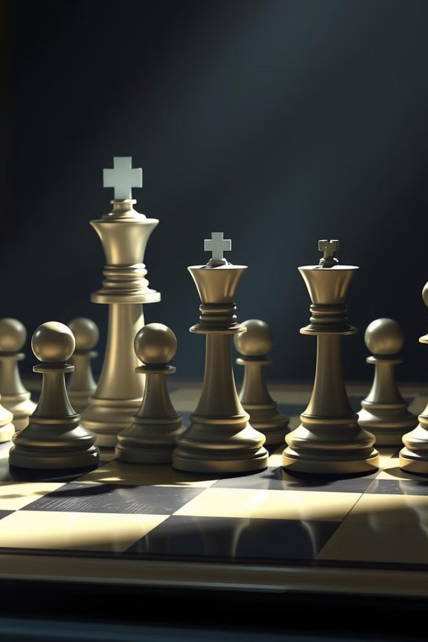
Building the
AI-Powered
Chess Game with Python

Slide 10
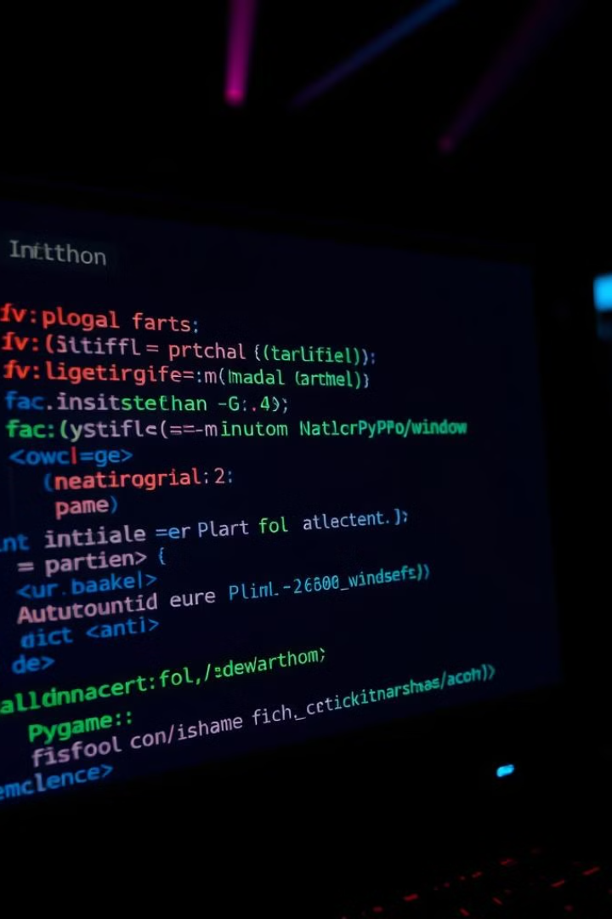
Setting Up the Game Environment: Initializing Pygame
The foundation of our chess game lies in Pygame, a powerful Python library for game development. First, we'll initialize Pygame, setting up the game window and event handling. This involves creating a display surface, loading necessary assets, and preparing the game loop.
We will create a window object with the size of the chess board. Setting display flags enables full-screen mode. Proper initialization of Pygame is crucial for handling user input and updating the game display.
Install Pygame
Initialize Pygame
Install the Pygame library using pip: pip install pygame.
Call pygame.init() to initialize all Pygame modules.
Set up the Display
Create the game window using pygame.display.set_mode((width, height)).

Slide 11
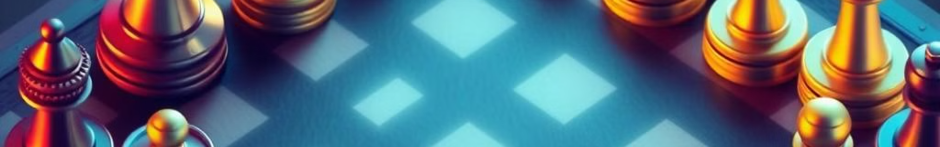



Drawing the Chessboard and Pieces
Visually representing the chessboard and pieces is crucial for an engaging game. We'll draw the chessboard using alternating colors for the squares and load images for each chess piece. Positioning these elements accurately on the board is essential for a visually appealing and intuitive interface.
Chessboard
Load Pieces
Positioning
Create a Chessboard Grid:
Import images for each chess piece
(PNG/SVG files)
Place the pieces on the board according to their initial positions.

Slide 12
Implementing Piece Movements
The core of the game lies in implementing valid piece movements. Each piece type (pawn, rook, knight, bishop, queen, king) has unique movement rules that must be accurately coded. This involves detecting user input, determining the selected piece, and validating the move based on the piece's capabilities and the current board state.
We'll create functions for each piece type to check the validity of a given move. For example, a rook can only move horizontally or vertically, while a knight moves in an L-shape. These functions will be invoked during the move validation process.
Movement Rules
User Input
Each piece type has unique movement rules.
Detect mouse clicks to select and move pieces.

Slide 13
Managing Game State and Player Turns
Proper game state management is crucial for tracking player turns, piece positions, and other relevant information. We'll implement a system to switch between players after each move, detect when a piece is captured, and update the board state accordingly. Efficiently managing this data ensures a seamless and accurate gameplay experience.
We will use a variable to store the current player's turn (e.g., "white" or "black"). After each valid move, we switch the turn to the other player. We also need to keep track of captured pieces and update the game display to reflect these changes.
1
Player Turns
2
Captured Pieces
3
Board State
Switch between players after each valid move.
Track and update captured pieces.
Update piece positions on the board after each move.

Slide 14
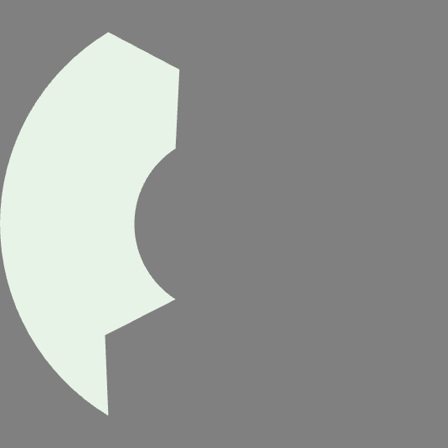


Implementing Move Validation
Validating moves ensures that only legal actions are allowed. This involves checking if the selected piece can move to the target square based on its movement rules, if the path is clear (no pieces blocking the way), and if the move puts the player's own king in check. Robust move validation prevents illegal moves and maintains the integrity of the game.
The move validation function must consider all possible scenarios and edge cases. It must handle pawn promotions, castling, and en passant captures correctly. This function is invoked before updating the game state to ensure the move's legality.
2
Path Clear
1
Piece Rules
Check
3

Slide 15



Detecting Check, Checkmate, and Stalemate
Implementing check, checkmate, and stalemate detection adds depth and complexity to the game. Check is detected when the king is under immediate threat. Checkmate occurs when the king is in check and has no legal moves to escape. Stalemate is when the player to move has no legal moves but is not in check. Accurate detection of these conditions is essential for determining the game's outcome.
The is_check function checks if the king is under attack. is_checkmate verifies if the king has no way of getting out of a check. is_stalemate checks if the current player has no legal moves and is not in check.
Check
Checkmate
Stalemate
King is under immediate threat.
King is in check with no escape.
No legal moves, not in check.

Slide 16
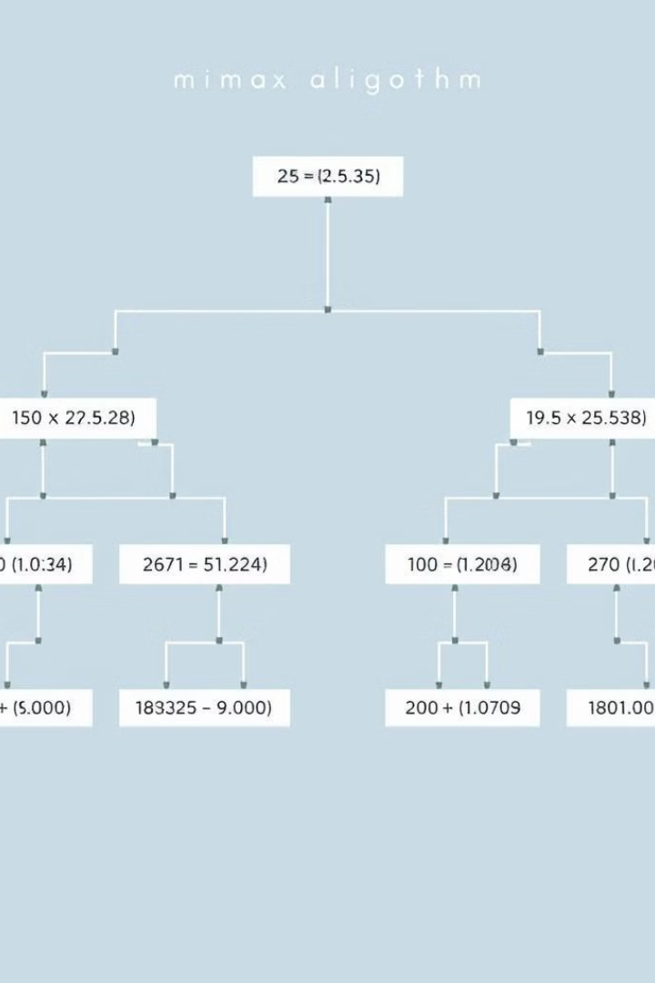
Minimax Algorithm
The Minimax algorithm forms the basis of our AI's decision-making process. It explores the possible game states by recursively evaluating moves, assuming that the opponent will always make the best move for themselves. This approach allows the AI to choose the move that maximizes its chances of winning, even if it requires sacrificing short-term gains.
The Minimax algorithm assigns scores to different game states, representing the advantage for one player over the other. The AI aims to maximize its score while minimizing the opponent's score.
1
Recursive Evaluation
Recursively evaluate moves.
2
Score Assignment
Assign scores to each game state.
3
Opponent Strategy
Assume opponent makes best move.

Slide 17
Implementing AI with Minimax Algorithm
Integrating the Minimax algorithm into our chess game creates a functional AI opponent. The AI evaluates all possible moves to a certain depth, using the Minimax algorithm to select the best move based on the evaluation scores. This provides a challenging and engaging opponent for human players to compete against.
The AI searches the game tree to a defined depth, where the depth determines how many moves ahead the AI looks. The deeper the search, the stronger the AI becomes, but the longer it takes to make a move.
Evaluate Moves
1
Evaluate all possible moves.
Select Best Move
2
Choose the move with highest score.
AI Opponent
3
Create engaging AI opponent.

Slide 18
Optimizing AI with Alpha-Beta Pruning
To improve the AI's performance, we can implement Alpha-Beta Pruning. This optimization technique reduces the number of nodes the Minimax algorithm needs to evaluate, significantly speeding up the AI's decision-making process without sacrificing accuracy. Alpha-Beta Pruning effectively prunes branches of the search tree that are guaranteed to be worse than previously found solutions, resulting in a more efficient AI opponent.
Alpha-Beta Pruning maintains two values, alpha and beta, representing the minimum score that the maximizing player is assured of and the maximum score that the minimizing player is assured of, respectively. It then prune branches that will not influence the final decision.
50%
0%
Faster
Sacrifice
Significantly speeds up AI decision making.
No decrease in AI accuracy.

Slide 19
Integrating AI into the Game Loop
Now that we have a working AI using the Minimax algorithm with Alpha-Beta Pruning, we need to make the AI play automatically on its turn.
Detect if it’s the AI’s turn.
Call the AI function (minimax() with pruning) to determine the best move.
Update the board state based on the AI’s chosen move.
Switch the turn back to the human player.
Example Integration in the Game Loop
Python if current_turn == "AI":
best_move = minimax(board, depth, -math.inf, math.inf, True)[1]
make_move(board, best_move)
current_turn = "Human"

Slide 20
Executing AI Moves
Once the AI selects a move, update the board matrix.
Move the piece and remove captured opponent pieces.
Add a slight delay to make AI moves feel natural.
Python pygame.time.delay(500) # Pause before AI move execution
make_move(board, best_move)
Checking for Game-End Conditions
After each AI move, check if the game has ended:
Checkmate → If the human player has no legal moves and is in check.
Stalemate → If the human player has no legal moves but isn’t in check.
Python if is_checkmate(board, "Human"):
print("AI wins by Checkmate!")
elif is_stalemate(board, "Human"):
print("Game Drawn by Stalemate!")

Slide 21



Finalizing the Game and UI Enhancements
With the AI seamlessly integrated, we shift our focus to the user interface (UI) and overall game polish. We'll design an intuitive and visually appealing UI to enhance player engagement. The UI will display the chessboard, available moves, and game status. UI improvements make the game more accessible and enjoyable for players of all skill levels.
Additional enhancements will include features like move highlighting, piece animations, and a clean, modern design. Proper UI design ensures users can easily interact with the game, understand the board state, and execute moves effectively.
Move Highlighting
Piece Animations
Modern Design
Visually indicate available moves for a selected piece.
Smooth transitions when pieces move across the board.
Clean and appealing visual aesthetic.

Slide 22
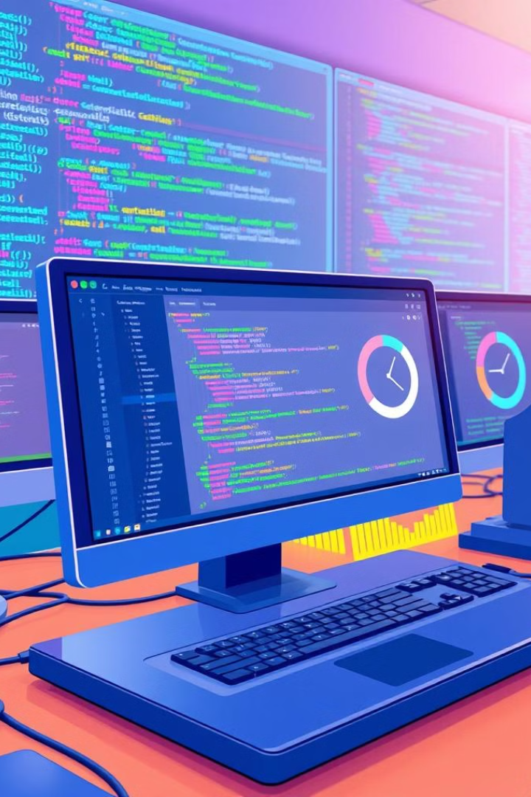



Testing and Refinement: Identifying and Fixing Bugs
Rigorous testing is essential to ensure a stable and enjoyable gaming experience. This involves identifying and fixing bugs, as well as optimizing performance to maintain smooth gameplay. We will employ automated testing to check move validity, AI decision-making, and UI responsiveness. Testing and refinement are continuous processes.
Collecting feedback from beta testers will provide valuable insights into real-world usability and potential areas for improvement. Addressing this feedback will make the game more appealing to a wide audience and enhance the user experience.
Bug Fixes
Optimization
Feedback
Address and resolve any glitches or errors in the game.
Enhance performance for smooth gameplay.
Incorporate user input for better usability.

Slide 23
Future Enhancements: Neural Networks and Deep Learning
Looking ahead, we can explore enhancing the AI using neural networks and deep learning techniques. These approaches can enable the AI to learn from previous games, adapt its strategies, and provide even more challenging gameplay. These advanced AI methods can elevate the game to a new level of sophistication.
Implementing neural networks would require a significant investment in data collection, training, and computational resources. However, the potential payoff in terms of AI performance and player engagement could be substantial. Such enhancements represent a cutting-edge approach to game AI development.

Slide 24
Conclusion
This project successfully demonstrates the development of an AI-powered chess game using Python and Pygame. By implementing a structured approach, we built a functional chessboard, programmed piece movements according to official chess rules, and integrated an AI opponent using the Minimax algorithm with Alpha-Beta Pruning. The AI effectively evaluates positions and makes optimal moves, creating a challenging gameplay experience.
Beyond the core functionality, we ensured smooth turn-based interactions, handled special chess rules, and optimized AI decision-making for efficiency. This project not only highlights the complexity of chess programming but also showcases how artificial intelligence can be applied to strategic games. The final outcome is a fully playable chess game where users can compete against an intelligent AI opponent, making it both an engaging and educational experience.
Thank You

